Slide 1
Predicting survival from titanic Dr. Tanushree Mahadani

Slide 2
Data Processing Opt1
Library Import
Data Loading
Data Analysis
Data Processing Opt2
import numpy as np
import matplotlib.pyplot as plt
import pandas as pd
import seaborn as sns
from sklearn.naive_bayes import GaussianNB
from sklearn.model_selection import train_test_split
from sklearn import metrics
from sklearn.metrics import confusion_matrix
from sklearn.preprocessing import StandardScaler
from sklearn.linear_model import LogisticRegression
from sklearn import preprocessing
from sklearn.neighbors import KNeighborsClassifier
from sklearn.tree import DecisionTreeClassifier
from sklearn import svm

Slide 3
Data Processing Opt1
Library Import
Data Loading
Data Analysis
Data Processing Opt2
train_data = pd.read_csv('train.csv')
test_data = pd.read_csv('test.csv')
gender_data = pd.read_csv('gender_submission.csv')
train data
Missing values
Data Cleaning
<class 'pandas.core.frame.DataFrame'>
RangeIndex: 891 entries, 0 to 890
Data columns (total 12 columns):
# Column Non-Null Count Dtype
--- ------ -------------- -----
0 PassengerId 891 non-null int64
1 Survived 891 non-null int64
2 Pclass 891 non-null int64
3 Name 891 non-null object
4 Sex 891 non-null object
5 Age 714 non-null float64
6 SibSp 891 non-null int64
7 Parch 891 non-null int64
8 Ticket 891 non-null object
9 Fare 891 non-null float64
10 Cabin 204 non-null object
11 Embarke 889 non-null object
dtypes: float64(2), int64(5), object(5)
memory usage: 83.7+ KB
PassengerId 0
Survived 0
Pclass 0
Name 0
Sex 0
Age 177
SibSp 0
Parch 0
Ticket 0
Fare 0
Cabin 687
Embarked 2
dtype: int64
Replace missing values in Age with median
train_data['Age'] =train_data['Age'].fillna(train_data['Age'].median())
Replace missing values in Cabin with mode
train_data['Cabin'].fillna(mode, inplace=True)
Replace missing values in Embarked with mode
train_data['Embarked'].fillna(mode, inplace=True)

Slide 4
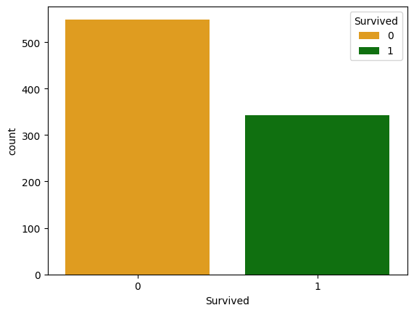
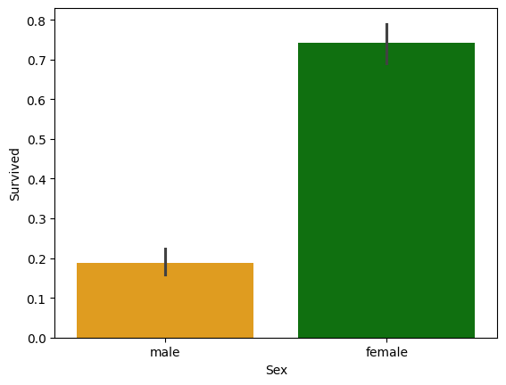
Data Processing Opt1
Library Import
Data Loading
Data Analysis
Data Processing Opt2
We found that only 36.0% of the passengers survived the crash, with significant differences in survival rates among different passenger classes, genders, and age groups.
Survived rate for Male
men = train_data.loc[train_data.Sex == 'male']["Survived"]
rate_men = sum(men)/len(men)*100
% of men who survived: 18.890814558058924
Survived rate for Female
women = train_data.loc[train_data.Sex == 'female']["Survived"]
rate_women = sum(women)/len(women)*100
% of women who survived: 74.20382165605095

Slide 5
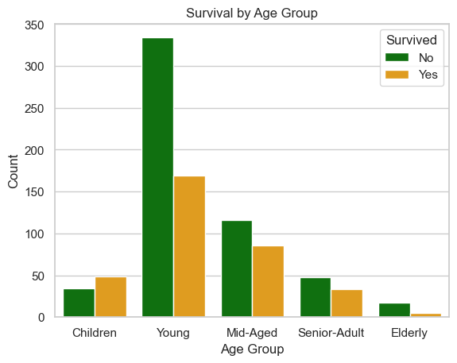
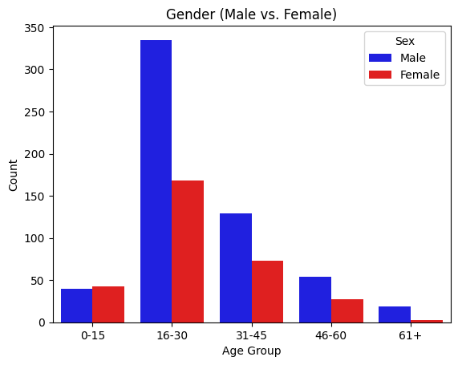
Data Processing Opt1
Library Import
Data Loading
Data Analysis
Data Processing Opt2
The highest death Group - Young Age (16 to 30 Years)
The highest survival Group – Children (<15 Years)

Slide 6
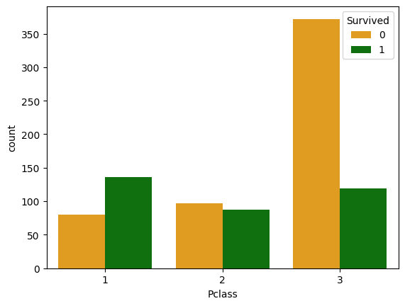
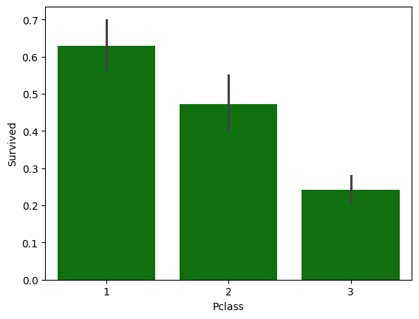
Data Processing Opt1
Library Import
Data Loading
Data Analysis
Data Processing Opt2
The least deaths occurred in Pclass = 1
The highest number of deaths occurred in Pclass = 3

Slide 7
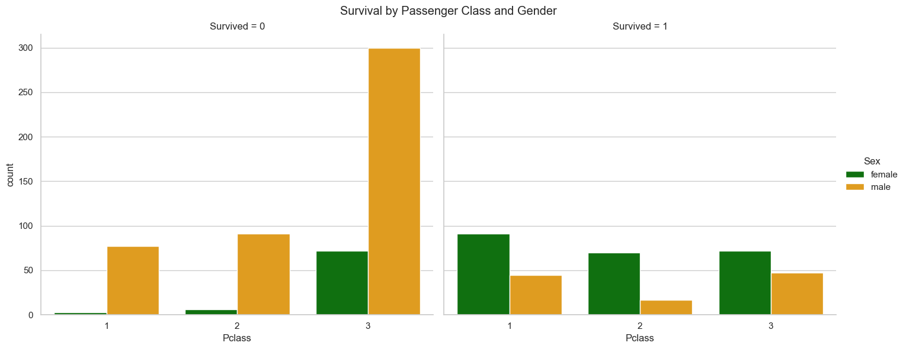
Data Processing Opt1
Library Import
Data Loading
Data Analysis
Data Processing Opt2
We observed that Pclass 3 had the highest number of deaths and a high ratio of males

Slide 8
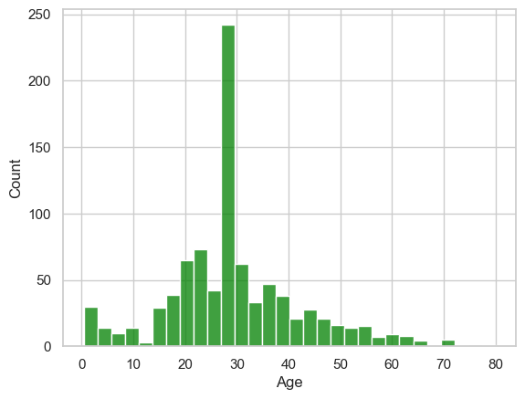
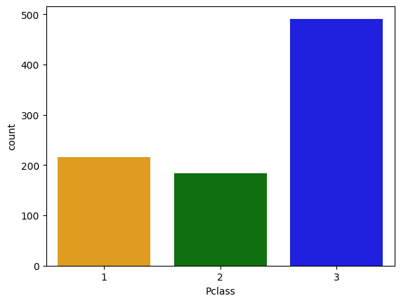
Data Processing Opt1
Library Import
Data Loading
Data Analysis
Data Processing Opt2
The maximum population belonged to the young age group (20-35)
The highest distribution of people was from Pclass = 3

Slide 9
Data Processing Opt1
Library Import
Data Loading
Data Analysis
Data Processing Opt2
Insert the survived column in the test data
test_data.insert(1,'Survived',gender_data['Survived’])
Drop some columns from train data
train_data.drop(['PassengerId','Name','SibSp','Parch','Ticket','Cabin','Embarked'],axis='columns',inplace=True)
Use label encoder
label_encoder = preprocessing.LabelEncoder()
train_data['Sex'] = label_encoder.fit_transform(train_data['Sex’])
Select data into independent and target variables
X_train = train_data.drop('Survived',axis='columns')
y_train = train_data['Survived’]
X_test = test_data.drop('Survived',axis='columns')
y_test = test_data['Survived’]
Naive bayes model
gausian_model = GaussianNB()
## using training data for fitting
gausian_model.fit(X_train, y_train)
Using test data to make prediction
y_pred = gausian_model.predict(X_test)
X_train
y_train
 | Pclass | Sex | Age | Fare
0 | 3 | 1 | 22.0 | 7.2500
1 | 1 | 0 | 38.0 | 71.2833
2 | 3 | 0 | 26.0 | 7.9250
3 | 1 | 0 | 35.0 | 53.1000
4 | 3 | 1 | 35.0 | 8.0500
... | ... | ... | ... | ...
886 | 2 | 1 | 27.0 | 13.0000
887 | 1 | 0 | 19.0 | 30.0000
888 | 3 | 0 | 28.0 | 23.4500
889 | 1 | 1 | 26.0 | 30.0000
890 | 3 | 1 | 32.0 | 7.7500
0 0
1 1
2 1
3 1
4 0
..
886 0
887 1
888 0
889 1
890 0

Slide 10
Data Processing Opt1
Library Import
Data Loading
Data Analysis
Data Processing Opt2
Create a dataframe with the prediction
pd.DataFrame({'Actual': y_test, 'Predicted':y_pred})
Actual Predicted
0 0 0
1 1 1
2 0 0
3 0 0
4 1 1
... ... ...
413 0 0
414 1 1
415 0 0
416 0 0
417 0 0
418 rows × 2 columns
Model evaluation
Measuring accuracy comparing prediction and real survive
print('Accurancy:', metrics.accuracy_score(y_test, y_pred))
Accurancy: 0.9497607655502392
Confusion matrix
conf_mat = confusion_matrix(y_test, y_pred)
conf_mat
array([[245, 21],
[ 0, 152]], dtype=int64)

Slide 11
Data Processing Opt1
Library Import
Data Loading
Data Analysis
Data Processing Opt2
Concatenate train_data and test_data along the rows (axis=0)
concatenated_data = pd.concat([train_data, test_data], axis=0)
Split our data into independent and target variables
X = concatenated_data[['Pclass','Sex','Age','Fare']]
y = concatenated_data['Survived’]
Split our data into 70% for training, 30% for testing
X_train, X_test, y_train, y_test = train_test_split(X, y, test_size=0.30, random_state=32)
Standard scaling
scaler = StandardScaler()
X_train = scaler.fit_transform(X_train)
X_test = scaler.transform(X_test)

Slide 12
Data Processing Opt1
Library Import
Data Loading
Data Analysis
Data Processing Opt2
Naive bayes model(Gaussian Model) | Option1 | Option2
Accurancy: | 0.9497607655502392 | 0.8473282442748091
From k-Nearest Neighbors (Knn) model | Option1 | Option2
Accurancy: | 0.7535885167464115 | 0.8498727735368957
DecisionTreeClassifier | Option1 | Option2
Accurancy(gini): | 0.784688995215311 | 0.8498727735368957
Accurancy(entropy): | 0.7464114832535885 | 0.8295165394402035
Accurancy(depth): | 0.9760765550239234 | 0.8676844783715013
Support vector machine | Option1 | Option2
Accurancy(Linear Kernel): | 1.0 | 0.8727735368956743
Accurancy(Sigmoid Kernel): | 0.7440191387559809 | 0.727735368956743
Accurancy(RBF Kernel): | 0.9688995215311005 | 0.8676844783715013

Slide 13
Thank You

Slide 14
Conclusion
36.0% of the passengers survived the Titanic crash
The survival rate for females was higher than that for males
The highest survival rate was observed in the Children group
The highest death rate was found in the Young Age group
The highest number of deaths occurred in Pclass = 3
The lowest number of deaths occurred in Pclass = 1

